Slide 1
Flipkart Reviews Sentiment Analysis
By SHATI BISWAS

Slide 2

Project Objective
PROBLEM STATEMENT:
Develop a Deep Learning model to analyze Flipkart product reviews and classify them as positive or negative based on user sentiment.
AIM:
Automatically classify customer reviews to improve product quality insights.

Slide 3
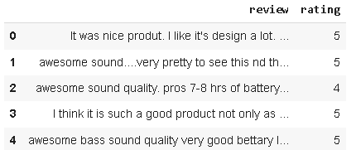
Dataset
Source: Flipkart Reviews Dataset

Slide 4
Project Goals & Methodology
Data Preparation
Data Preprocessing
EDA

Slide 5
Sentiment Analysis Techniques & Results
Model 1:
VADER (Valence Aware Dictionary and sentiment Reasoner)
Approach: Bag-of-words model. It uses a lexicon and a set of grammatical rules to determine the sentiment of text.

Slide 6
DATA PREPROCESSING:
Remove missing values and duplicate entries.
Convert text to lowercase.
Remove stopwords, punctuation, and special characters.
Tokenize text data using TF-IDF (Term Frequency-Inverse Document Frequency).
Encode sentiment labels (Positive = 1, Negative = 0).
Split dataset into training (80%) and testing (20%) sets.
For the BERT model, a subset of 1000 reviews was used for analysis.

Slide 7
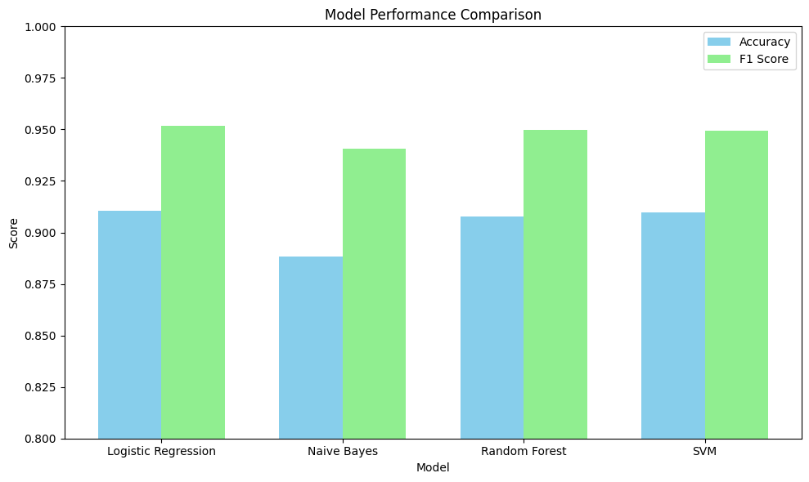
Sentiment Analysis Techniques & Results

Slide 8
Sentiment Analysis Techniques & Results Model Evaluation and Prediction:
Logistic Regression –
Accuracy: 0.9104, F1 Score: 0.9516
Naive Bayes –
Accuracy: 0.8882, F1 Score: 0.9407
Random Forest –
Accuracy: 0.9079, F1 Score: 0.9496
SVM –
Accuracy: 0.9098, F1 Score: 0.9494

Slide 9
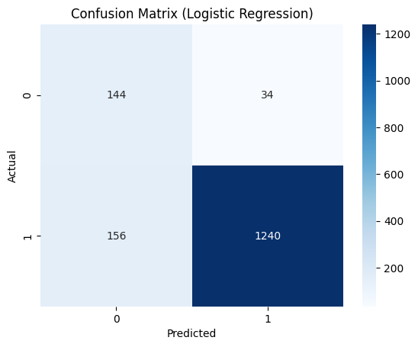
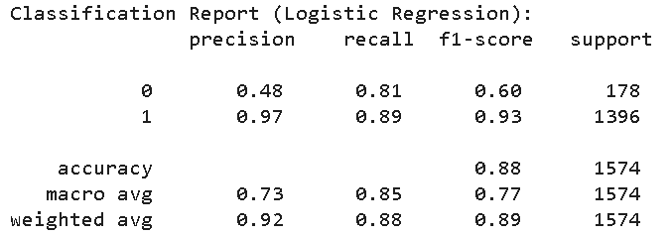
Sentiment Analysis Techniques & Results Model Evaluation and Prediction:

Slide 10
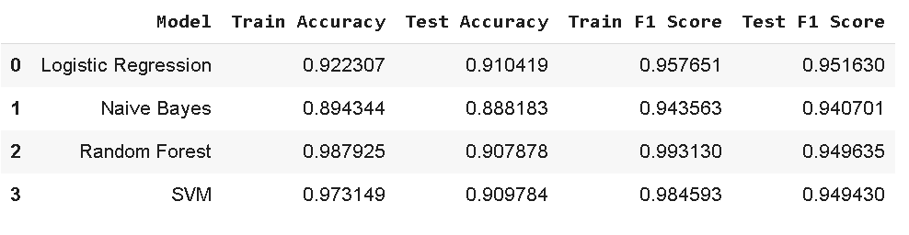
Comparative Results

Slide 11
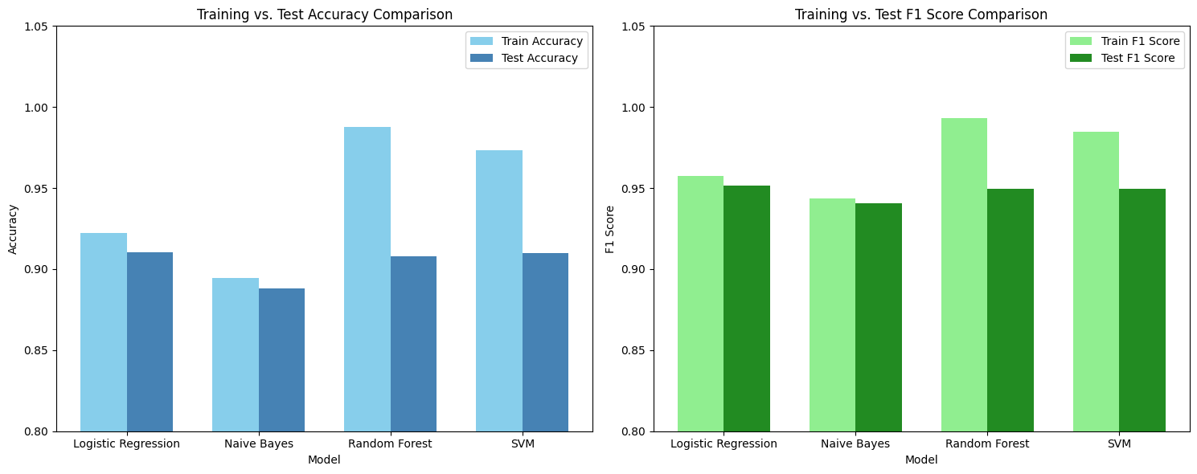
Comparative Results -Visualization

Slide 12

Predict on New Data

Slide 13
To Extend this: Flipkart Reviews Sentiment Analysis with BERT
Key Techniques Explored:
VADER (Valence Aware Dictionary and sentiment Reasoner) - A lexicon and rule-based sentiment analysis tool.
RoBERTa - Pretrained Model from Hugging Face - A state-of-the-art transformer-based model.
Hugging Face Pipeline - For efficient model application.

Slide 14
Data Acquisition & Initial Exploration
The dataset contains review text and rating (1-5 stars).
Shape: (9976, 2) - indicating 9976 reviews.
Data Subset for Analysis: For this analysis, the dataset was truncated to the first 1000 entries to manage computational resources, especially for the BERT model.
New Shape: (1000, 2)
Duplicate Removal: Duplicates were removed from the subset to ensure unique reviews.

Slide 15
Data Preprocessing & Sentiment Labeling
Logic:
rating >= 4 was classified as 1 (Positive).
rating < 4 was classified as 0 (Negative).
Sentiment Distribution:
Positive (1): 901 reviews
Negative (0): 99 reviews
Observation: The dataset is highly imbalanced, with a significant majority of positive reviews.

Slide 16
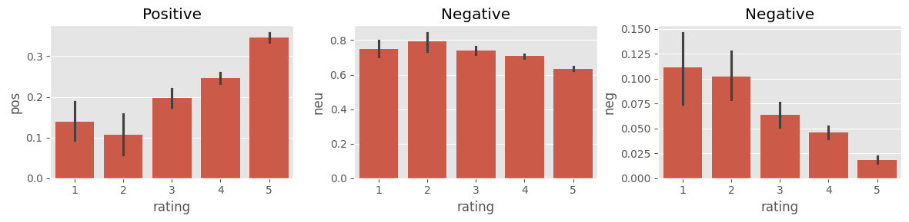
Sentiment Analysis with VADER

Slide 17
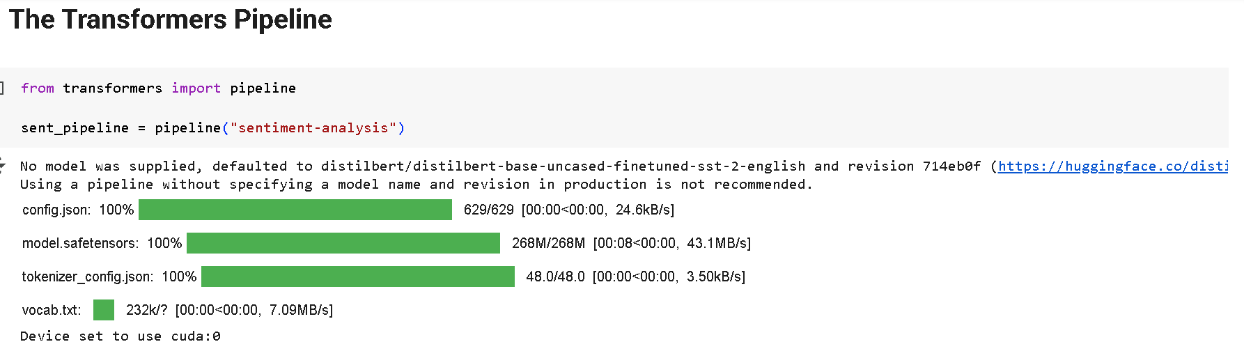
Roberta Pretrained Model

Slide 18
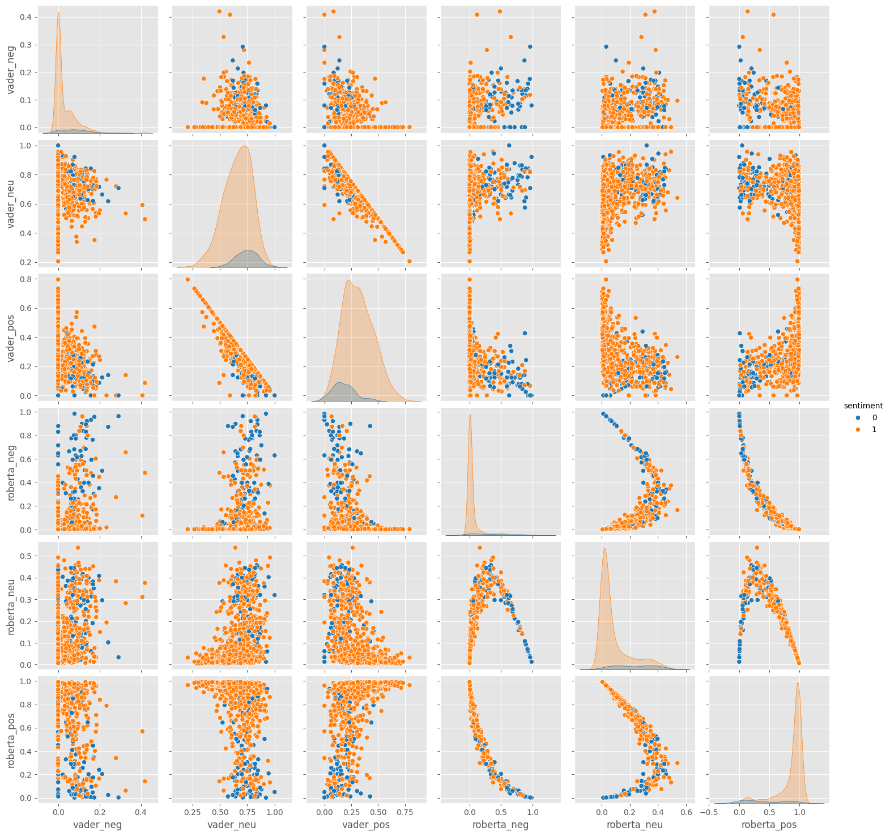
Roberta Pretrained Model

Slide 19
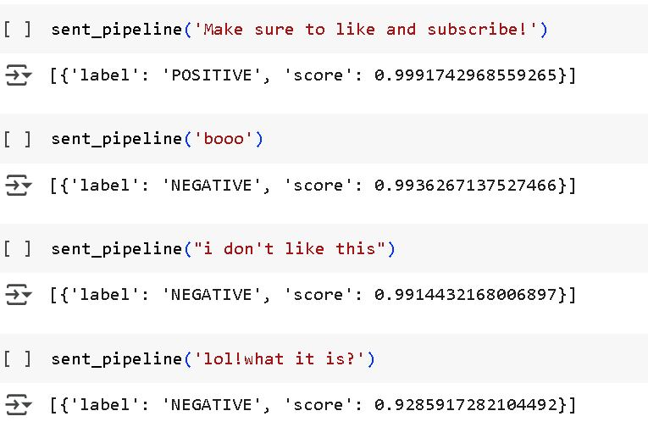
Roberta Pretrained Model Output:

Slide 20
Conclusion
VADER's Performance: VADER proved effective in aligning sentiment scores with star ratings, demonstrating its utility as a quick and interpretable sentiment analysis tool.
RoBERTa's Potential: RoBERTa, as a transformer model, offers a more sophisticated understanding of context, which can lead to more accurate sentiment classification, especially for complex or nuanced reviews. The pair plot suggests it might offer a clearer separation between positive and negative sentiments in some cases.

Slide 21
Thank You

